Slide 1

Clash of Cultures Series
Science and (un)Belief (Feb 21st)
Sex and Divine Intimacy (march 6th)
Gender confusion: lgb or t? – Some Catholic perspectives (Mar 20th)
________________________________
See www.MissionCap.org/resources for powerpoints and a recording of the talks
© Mission Capital

Slide 2
Opening Prayer: Psalm 139
¹ O Lord, you have searched me and known me.
² You know when I sit down and when I rise up;
you discern my thoughts from far away.
³ You search out my path and my lying down,
and are acquainted with all my ways.
⁴ Even before a word is on my tongue,
O Lord, you know it completely.
⁵ You hem me in, behind and before,
and lay your hand upon me.
⁶ Such knowledge is too wonderful for me;
it is so high that I cannot attain it.
⁷ Where can I go from your spirit?
Or where can I flee from your presence?
⁸ If I ascend to heaven, you are there;
if I make my bed in Sheol, you are there.
⁹ If I take the wings of the morning
and settle at the farthest limits of the sea,
¹⁰ even there your hand shall lead me,
and your right hand shall hold me fast.
¹¹ If I say, “Surely the darkness shall cover me,
and the light around me become night,”
¹² even the darkness is not dark to you;
the night is as bright as the day,
for darkness is as light to you.
¹³ For it was you who formed my inward parts;
you knit me together in my mother’s womb.
¹⁴ I praise you, for I am fearfully and wonderfully made.
Wonderful are your works; that I know very well.
¹⁵ My frame was not hidden from you,
when I was being made in secret,
intricately woven in the depths of the earth.
¹⁶ Your eyes beheld my unformed substance.
In your book were written
all the days that were formed for me,
when none of them as yet existed.
¹⁷ How weighty to me are your thoughts, O God!
How vast is the sum of them!
¹⁸ I try to count them—they are more than the sand;
I come to the end^{[a]}—I am still with you.
© Mission Capital

Slide 3


Sex and Divine Intimacy
Sex and Divine Intimacy considers how our culture diverts the divine flame of sexual intimacy from co-creating divine images (kids) to scorching them (us).
Triumph of the Erotic and its Wake of Destruction
Divine Intimacy in Scripture and the Saints
True Sex Ed: Lessons from Scripture and Neuroscience
True Love: Helping Others out of Confusion and Disorder and into Divine Intimacy
© Mission Capital

Slide 4
I. Triumph of the Erotic and its Wake of Destruction
Return to a Biblical Clash:
1st Century Palestinian Jewish culture clashed with Hellenism
Age of Christendom: Constantine (315) to Sexual Revolution (60s)
How to boil frogs in a lidless pot: Creation of the ‘New Normal’
50 year extraction of God, sin, & divine intimacy from the culture
The ‘New Normal’ is like Old Rome

Slide 5
Triumph of the Erotic: 1970 to Present
Polls Data | 1972-3 | 1989 | 2020-3
Adults who habitually watch Porn¹ | n/a |  | 58%
Premarital Sex: Not Wrong at All² | 26% |  | 68%
Same Sex Sex: Not Wrong at All² | 11% |  | 59%
Support Same Sex Marriage³ | n/a | 12% | 70%
Secular ‘Culture’ vaults sexual pleasure to the top (along with power)
Licentiousness (late 60s) → Hookup&Homo (00s+) → Poly Amory (now) → Bestiality/Pederasty/Sex Trade (2030?)
¹ GSS. ² https://www.statista.com/statistics/1402222/us-adults-pornography-habit/ ³https://en.wikipedia.org/wiki/Public_opinion_of_same-sex_marriage_in_the_United_States ..
© Mission Capital

Slide 6
New Normal →
New Religion & Worldview
Practical Atheism
Moralistic Therapeutic Deism
© Mission Capital

Slide 7

A study of 3,000 religious American youth by Christian Smith and Melinda Denton in 2005 found that many young people believe in several moral statutes not exclusive to any of the major world religions … [but rather] a set of commonly held spiritual beliefs:
A God exists who created and ordered the world and watches over human life on earth.
God wants people to be good, nice, and fair to each other, as taught in the Bible and by most world religions.
The central goal of life is to be happy and to feel good about oneself.
God does not need to be particularly involved in one's life except when God is needed to resolve a problem.
Good people go to heaven when they die.
Soul Searching: The Religious and Spiritual Lives of American Teenagers (2005); "Nat’l Study of Youth & Religion", (https://youthandreligion.nd.edu).
© Mission Capital

Slide 8
Christian Moralistic Therapeutic Deism
A significant part of Christianity in the US … has substantially morphed into Christianity's misbegotten step-cousin, Christian MTD. (Soul Searching, p. 171)
God is "like a combination Divine Butler and Cosmic Therapist: always on call, takes care of any problems, professionally helps his people feel better about themselves, and but is not too personally involved in the process." (Soul Searching, p. 165)
The problem does not seem to be that churches are teaching young people badly, but that we are doing an exceedingly good job of teaching youth what we really believe, namely, that
(a) Christianity is not a big deal (c) the church is a helpful social institution
(b) God requires little (d) filled with nice people…
"More Teens Becoming Fake Christians" on Princeton’s Kenda Dean's 2010 book Almost Christian: What the Faith of Our Teenagers is Telling the American Church. (Oxford University Press, 2010). http://www.cnn.com/2010/LIVING/08/27/almost.christian/index.html
© Mission Capital

Slide 9

Popular Post-Modernism:
Practical Atheism
Absolute truth doesn’t exist
Reason is only one form of parochial knowledge
Truth claims are typically masked assertions of power
Morality is relative
Nothing is universal
Nobody can really know anything for certain
(p 6, Smith, Christian. Young Catholic America. (Oxford University Press, 2014)
© Mission Capital

Slide 10

Wake of Destruction
No Family / Maybe One Parent / Isolation / Orcification
Infanticide / New Eugenics / Euthanasia young, old and in between
© Mission Capital

Slide 11

Real World Practice
Think of a specific family member, friend or co-worker who is either struggling with some type of sexual disorder or is just confused about Catholic sexual morality. Picture a conversation with them and jot down some ways you would respond to,
“Why are you Christians so hung up on Sex? No one gets hurt by masturbation, pornography, or any kind of sex outside of marriage …”
______________________________________________________________________________________________________________________________________________________________________________________________________________________________________________________________________________________________________________________________________________________________________________________________________________________________________________________________________________________________________________________________________________________________________
© Mission Capital

Slide 12
II. Divine Intimacy in Scripture and the Saints
We were made for Intimacy with God
Intimacy with Jesus is like His with the Father (Gospel of John)
Our Bodies are Temples of the Holy Spirit
Baptism joins us to the Lord’s Body
Mystical Theology: note and references
© Mission Capital

Slide 13
God Made Us for Intimacy with Him
God Made Us Like Himself to Be with Him
⁻ Then God said, “Let us make man in our image, after our likeness^{1.26-}…. So God created man in his own image, in the image of God he created him; male and female he created them…
The Lord God took the man and put him in the garden of Eden to till it and keep it^{2.15} … ^{3.8} And they heard the sound of the Lord God walking in the garden in the cool of the day. (Gen 1-3)
-The eternal life which was with the Father and made manifest to us … [we proclaim] ³ so that you may have fellowship with us; and our fellowship is with the Father and with his Son Jesus Christ. (I Jn 1²⁻³)
God Made and Knows Each of Us
¹ O Lord, you have searched me and known me. ² You know when I sit down and when I rise up; you discern my thoughts from far away. ³ You search out my path and my lying down, and are acquainted with all my ways. ⁴ Even before a word is on my tongue, O Lord, you know it completely… ¹³ For it was you who formed my inward parts; you knit me together in my mother’s womb. (Ps 139)
God Sees Us ‘Under the Fig Tree’
⁴⁷ Jesus saw Nathanael coming and said, “Here is truly an Israelite in whom there is no deceit!” ⁴⁸ Nathanael asked, “Where did you get to know me?” Jesus answered, “I saw you under the fig tree before Philip called you.” (Jn 1)
He Calls us by Name
The sheep hear his voice, and he calls his own sheep by name and leads them out. (Jn 10)
The ‘Abba’ Intimacy of Children
¹² to all who received him, who believed in his name, he gave power to become children of God (Jn 1¹²)
God Proves His Love & Pours It into Our Hearts
⁸ But God proves his love for us in that while we still were sinners Christ died for us … ⁵God poured his love into our hearts through the Holy Spirit that has been given to us. (Rom 5)
© Mission Capital

Slide 14
John: Intimacy with Jesus is like His with the Father
Eternal life 6⁵⁷
⁵⁷ As the living Father sent me, and I live because of the Father, so he who eats me will live because of me.
Mutual knowing 10¹⁴⁻¹⁵
¹⁴ I am the good shepherd; I know my own and my own know me, ¹⁵ as the Father knows me and I know the Father; and I lay down my life for the sheep.
Mutual abiding 14^{10,20}, 17²¹
14¹⁰ Do you not believe that I am in the Father and the Father in me? The words that I say to you I do not speak on my own authority; but the Father who dwells in me does his works. ¹¹ Believe me that I am in the Father and the Father in me; or else believe me for the sake of the works themselves.
14²⁰ In that day you will know I am in my Father, you in me, and I in you.
15⁴ Abide in me, and I in you. As the branch cannot bear fruit by itself, unless it abides in the vine, neither can you, unless you abide in me.
17²⁰ “I do not pray for these only, but also for those who believe in me through their word, ²¹ that they may all be one; even as thou, Father, art in me, and I in thee, that they also may be in us,
Participation in Spirit 1³³ 14¹⁶⁻⁷
¹⁶ And I will pray the Father, and he will give you another Counselor, to be with you for ever, ¹⁷ even the Spirit of truth … you know him, for he dwells with you, and will be in you.
Participation in love 15⁹⁻¹⁰, 17²⁶
15⁹ As the Father has loved me, so have I loved you; abide in my love. ¹⁰ If you keep my commandments, you will abide in my love, just as I have kept my Father’s commandments and abide in his love.
17²⁶ [Jesus prays] that the love with which thou hast loved me may be in them, and I in them.
Participation in glory 17²²
The glory which thou hast given me I have given to them, that they may be one even as we are one.
Sonship 20¹⁷
Jesus said to [Mary Magdalen], “Do not hold me, for I have not yet ascended to the Father; but go to my brethren and say to them, I am ascending to my Father and your Father, to my God and your God.”
© Mission Capital
Eternal life 6⁵⁷
⁵⁷ As the living Father sent me, and I live because of the Father, so he who eats me will live because of me.
Mutual knowing 10¹⁴⁻¹⁵
¹⁴ I am the good shepherd; I know my own and my own know me, ¹⁵ as the Father knows me and I know the Father; and I lay down my life for the sheep.
Mutual abiding 14²⁰, 17²¹
14¹⁰ Do you not believe that I am in the Father and the Father in me? The words that I say to you I do not speak on my own authority; but the Father who dwells in me does his works. ¹¹ Believe me that I am in the Father and the Father in me; or else believe me for the sake of the works themselves.
14²⁰ In that day you will know I am in my Father, you in me, and I in you.
15⁴ Abide in me, and I in you. As the branch cannot bear fruit by itself, unless it abides in the vine, neither can you, unless you abide in me.
17²⁰ “I do not pray for these only, but also for those who believe in me through their word, ²¹ that they may all be one; even as thou, Father, art in me, and I in thee, that they also may be in us,
Participation in Spirit 1³³ 14¹⁶⁻⁷
¹⁶ And I will pray the Father, and he will give you another Counselor, to be with you for ever, ¹⁷ even the Spirit of truth … you know him, for he dwells with you, and will be in you.
Participation in love 15⁹⁻¹⁰, 17²⁶
15⁹ As the Father has loved me, so have I loved you; abide in my love. ¹⁰ If you keep my commandments, you will abide in my love, just as I have kept my Father’s commandments and abide in his love.
17²⁶ [Jesus prays] that the love with which thou hast loved me may be in them, and I in them.
Participation in glory 17²²
The glory which thou hast given me I have given to them, that they may be one even as we are one.
Sonship 20¹⁷
Jesus said to [Mary Magdalen], “Do not hold me, for I have not yet ascended to the Father; but go to my brethren and say to them, I am ascending to my Father and your Father, to my God and your God.”

Slide 15
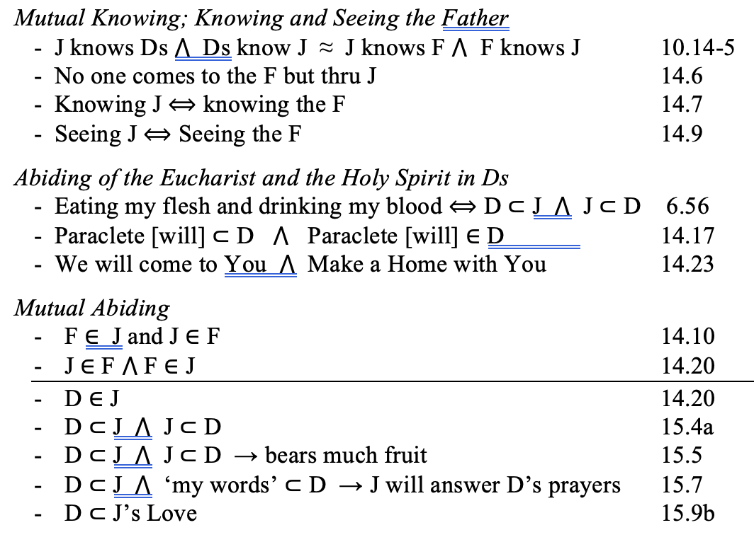
Reference Chart: Abiding in Eucharist, Jesus & HS
(Gospel of John)
Note: ∈ means “be in”; ⊂ means “abide in”; ⟺ means “the same as”; and ⋀ means “and“.
© Mission Capital

Slide 16
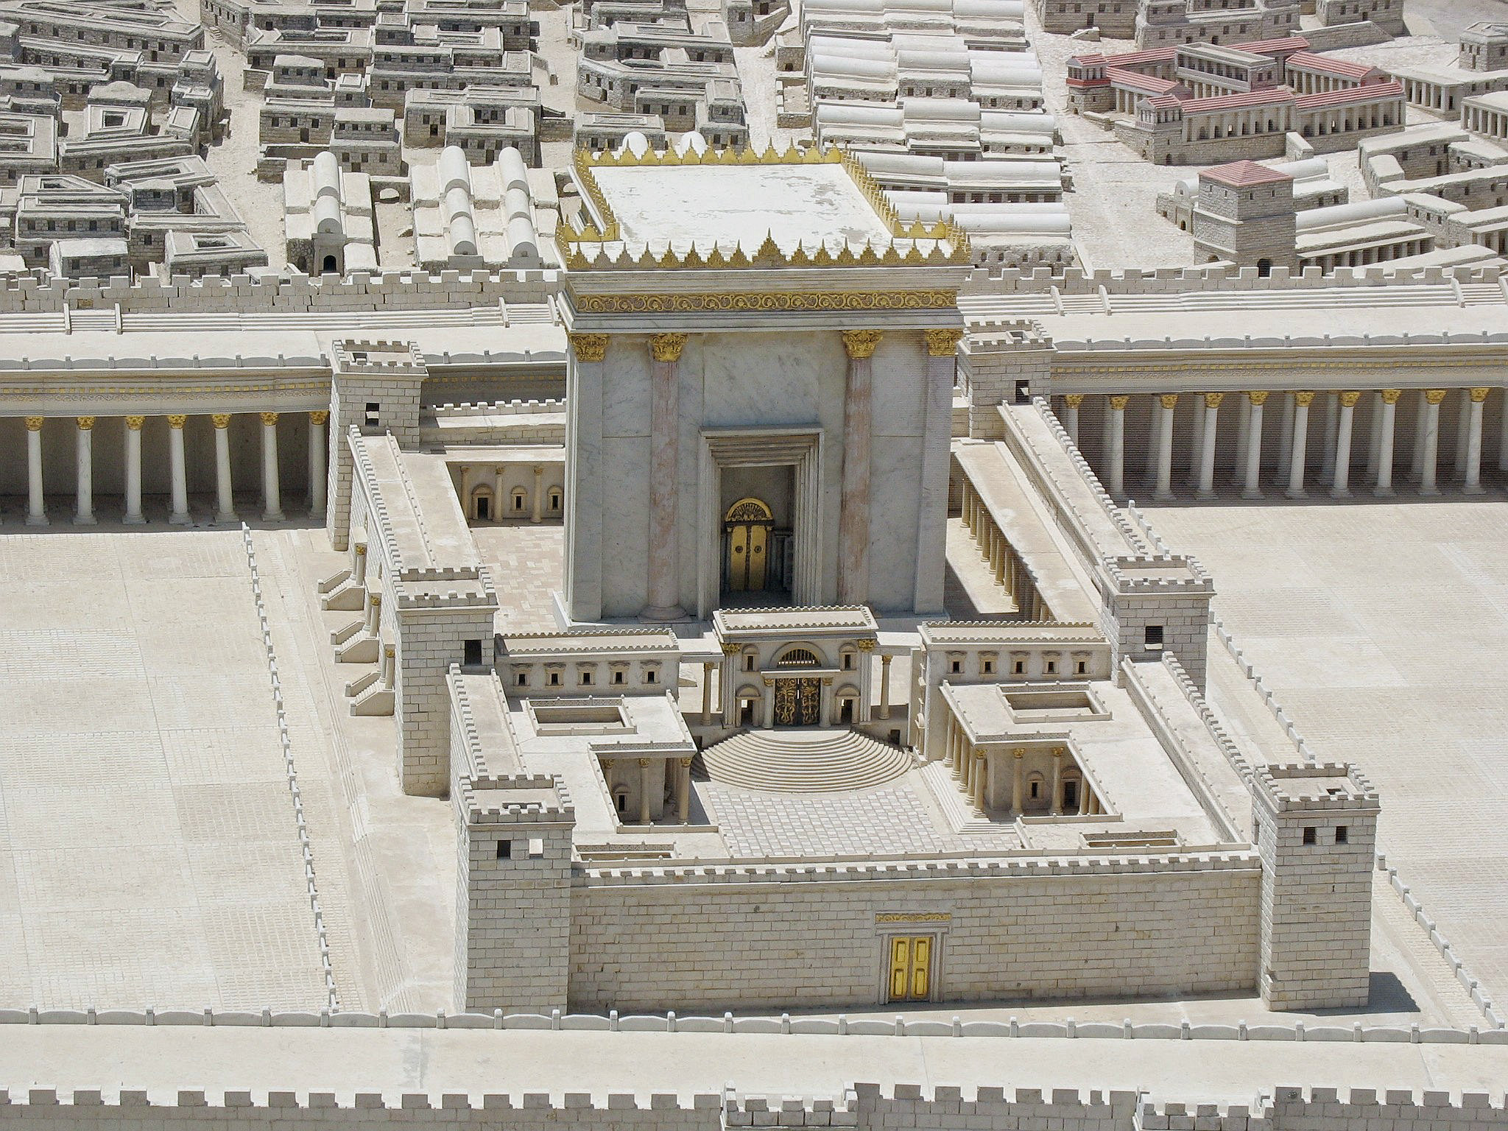
Our Bodies are Temples of the Holy Spirit
Do you not know that you are God’s temple and that God’s Spirit dwells in you? If anyone destroys God’s temple, God will destroy that person. For God’s temple is holy, and you are that temple.
I Corinthians 3¹⁶⁻⁷
The body is meant not for fornication but for the Lord, and the Lord for the body. ¹⁴ And God raised the Lord and will also raise us by his power.
¹⁵ Do you not know that your bodies are members of Christ? Should I therefore take the members of Christ and make them members of a prostitute? Never!
¹⁶ Do you not know that whoever is united to a prostitute becomes one body with her? For it is said, “The two shall be one flesh.” ¹⁷ But anyone united to the Lord becomes one spirit with him. ¹⁸ Shun fornication! Every sin that a person commits is outside the body; but the fornicator sins against the body itself.
¹⁹Or do you not know that your body is a temple of the Holy Spirit within you, which you have from God, and that you are not your own? ²⁰ For you were bought with a price; therefore glorify God in your body. I Corinthians 6¹³⁻²⁰
© Mission Capital

Slide 17
I Corinthians: Baptism joins us to the Lord’s Body
Temples of the Holy Spirit
Do you not know that you are God’s temple and that God’s Spirit dwells in you? If anyone destroys God’s temple, God will destroy that person. For God’s temple is holy, and you are that temple. (I Cor 3¹⁶⁻⁷)
The body is meant not for fornication but for the Lord, and the Lord for the body. ¹⁴ And God raised the Lord and will also raise us by his power.
¹⁵ Do you not know that your bodies are members of Christ? Should I therefore take the members of Christ and make them members of a prostitute? Never!
¹⁶ Do you not know that whoever is united to a prostitute becomes one body with her? For it is said, “The two shall be one flesh.” ¹⁷ But anyone united to the Lord becomes one spirit with him. ¹⁸ Shun fornication! Every sin that a person commits is outside the body; but the fornicator sins against the body itself.
¹⁹Or do you not know that your body is a temple of the Holy Spirit within you, which you have from God, and that you are not your own? ²⁰ For you were bought with a price; therefore glorify God in your body. (I Cor 6¹³⁻²⁰)
Baptism joins us to the Body of the Lord
thru baptism 1.13-17, 6.11, 12.13
Though one, has many members 12:12; 14ff; 20-24
Our physical bodies will be resurrected ‘spiritual bodies’ In the ‘Image of the man from heaven’ (= Jesus) (15.42-9)
Baptism redeems us (buys back from slavery), making us Christ’s
Belong not to Paul … but to God (1.12-16); We are Christ’s (3.23)… not our own [since] we were bought with a price (6.19b)
A slave is a ‘freed person belonging to Christ – for you were bought (back from slavery) with a price (7.22-3)
‘Those who belong to the Lord’ will be resurrected (15.23)
Sin against Brethren and one’s Body is sin against the Lord
Sexual immorality is a sin against the body - 6.18
Sinning against brethren is sinning against the Lord 8.12
Glorify God in your body - 6.20b
Compete like a runner to obtain the prize of eternal life, pommel [the] body like a boxer in order to gain self-control, and enslave it (9.24-27).
Eucharistic is a ‘communion’ in the Body of Christ
Eucharist is communion with blood and body of Christ 10.16
Partaking of ‘One Bread’(=body of Christ) makes us ‘One Body’ 10.17
‘This is my body’ … 11.27-29
© Mission Capital

Slide 18

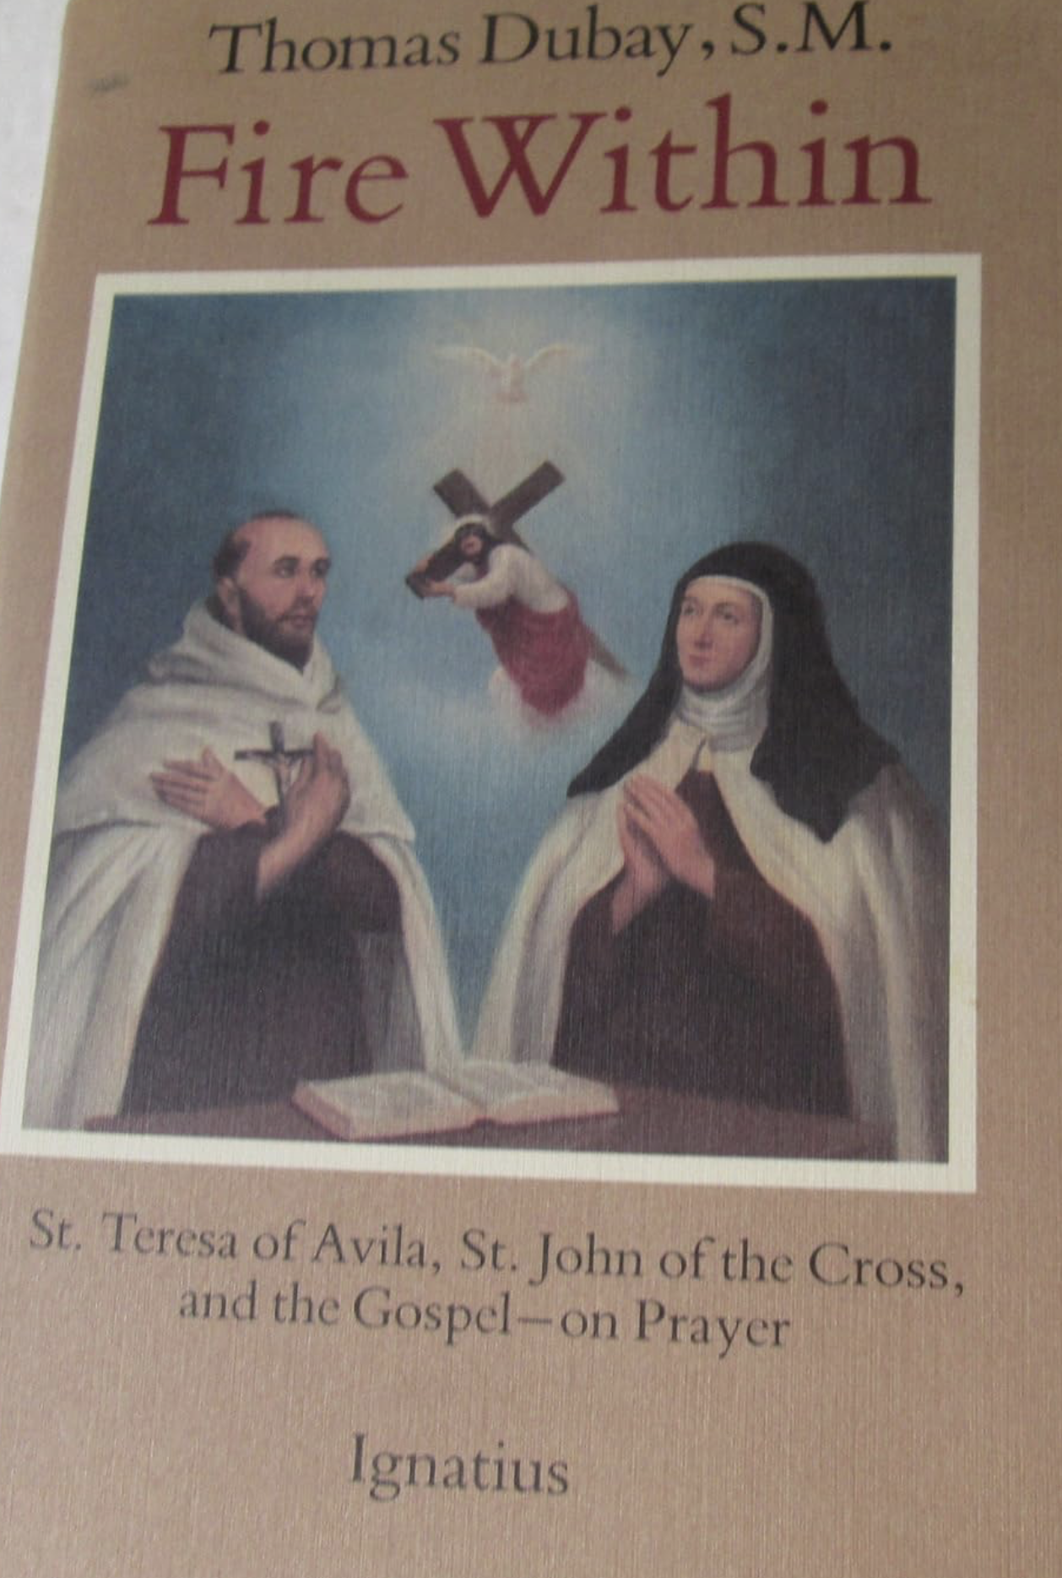
The Mystical Theology of the Saints
Ecstasy: ¹standing outside yourself out of yourself; ²an overwhelming feeling of great happiness; ³an amphetamine-based recreational drug having euphoric effects
Ecstasy of Marital Intercourse →
Souls of Spouses Uniting
Ecstasy of Mystical Union →
Soul Uniting with Holy Spirit
© Mission Capital

Slide 19





III. True Sex Ed: Lessons from Scripture and Neuroscience
The four primary loves of Greek Philosophy
The Neuroscience of Sex
  Homeostasis
  Visual Arousal
Why did the Lord create us with Sexual Pleasure?
  The pleasure in the union of both parts of the divine image – male and female - may point to the rapture of the divine union
Ecstatic pleasure of sex vs Ecstatic Delight of the Divine Unitive
Sex: Sharing in the Divine Flame of Creation
© Mission Capital

Slide 20




First, Catholic Sexual Morality
Mortal Sin: gravely disordered act + knowingly done + freely done (CCC 1857-60)
➔ without repentance and God’s forgiveness, excludes you from God’s Kingdom and causes eternal death of Hell (1861)
Venial Sin: a disordered act that lacks either gravity, knowledge or freedom (CCC 1862)
Mortal Sexual Sins (if done knowingly and freely)
Fornication: carnal union between an unmarried man and an unmarried woman. 2353
Masturbation: the deliberate stimulation of the genital organs in order to derive sexual pleasure. … masturbation is an intrinsically and gravely disordered action."¹³⁸ "The deliberate use of the sexual faculty, for whatever reason, outside of marriage is essentially contrary to its purpose." 2352
Pornography: consists in removing real or simulated sexual acts from the intimacy of the partners, in order to display them deliberately to third parties. … It is a grave offense. 2354
Homosexual Acts: refers to relations between men or between women who experience an exclusive or predominant sexual attraction toward persons of the same sex. … "homosexual acts are intrinsically disordered."¹⁴² 2357
Venial Sexual Sins (if done knowingly and freely)
Lust: disordered desire for or inordinate enjoyment of sexual pleasure. Sexual pleasure is morally disordered when sought for itself, isolated from its procreative and unitive purposes. 2351
© Mission Capital
Mortal Sin: gravely disordered act + knowingly done + freely done (CCC 1857-60)
➔ without repentance and God’s forgiveness, excludes you from God’s Kingdom and causes eternal death of Hell (1861)
Venial Sin: a disordered act that lacks either gravity, knowledge or freedom (CCC 1862)
Mortal Sexual Sins (if done knowingly and freely)
Fornication: carnal union between an unmarried man and an unmarried woman. 2353
Masturbation: the deliberate stimulation of the genital organs in order to derive sexual pleasure. … masturbation is an intrinsically and gravely disordered action."¹³⁸ "The deliberate use of the sexual faculty, for whatever reason, outside of marriage is essentially contrary to its purpose." 2352
Pornography: consists in removing real or simulated sexual acts from the intimacy of the partners, in order to display them deliberately to third parties. … It is a grave offense. 2354
Homosexual Acts: refers to relations between men or between women who experience an exclusive or predominant sexual attraction toward persons of the same sex. … "homosexual acts are intrinsically disordered."¹⁴² 2357
Venial Sexual Sins (if done knowingly and freely)
Lust: disordered desire for or inordinate enjoyment of sexual pleasure. Sexual pleasure is morally disordered when sought for itself, isolated from its procreative and unitive purposes. 2351

Slide 21
True Sex Ed: Lessons from Scripture
Sexual Sin Cuts Us Off from the Lord
⁹ Do you not know that wrongdoers will not inherit the kingdom of God? Do not be deceived! Fornicators, idolaters, adulterers, male prostitutes, sodomites, ¹⁰ thieves, the greedy, drunkards, revilers, robbers—none of these will inherit the kingdom of God. ¹¹ And this is what some of you used to be. But you were washed, you were sanctified, you were justified in the name of the Lord Jesus Christ and in the Spirit of our God. (I Cor 6)
Even Lust is Deadly
²⁷ “You have heard that it was said, ‘You shall not commit adultery.’ ²⁸ But I say to you that everyone who looks at a woman with lust has already committed adultery with her in his heart. ²⁹ If your right eye causes you to sin, tear it out and throw it away; it is better for you to lose one of your members than for your whole body to be thrown into hell. (Mt 5.27-29).
Why? Divine Intimacy Requires Holiness
Strive for … the holiness without which no one will see the Lord. (Heb 12.14)
You Shall be Holy for I am Holy (I Peter 1.16; Leviticus 11.44-5)
You, therefore, must be perfect, as your heavenly Father is perfect. (Mt 5.48)
© Mission Capital

Slide 22
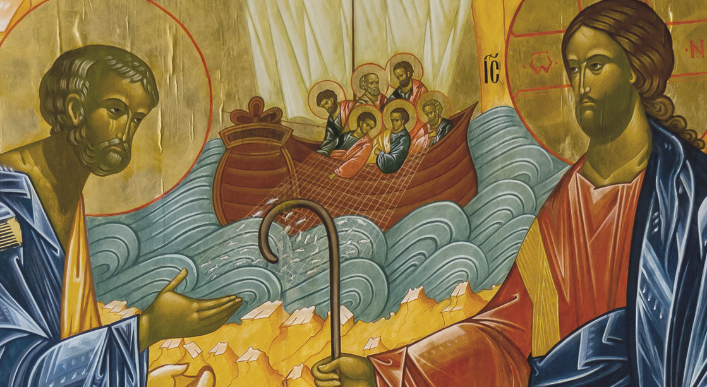
God’s Love: Hesed, Agape & Philia
Hebrew: Steadfast Love
  OT/Hb, hesed (esp. Ex 34.6ff)
  OT/Hb, aheb: “inner force which impels … self-sacrifice
  for the good of the loved one (Lv 19.18,34)
  and unswerving loyalty (e.g. I Sam 20.17-42)
Greek notions of ‘love’
  Eros: erotic, passionate love.
  Philia < φιλῶ>: love of friends and equals.
  Storge: love of parents for children.
  Agape <ἀγαπᾷς> : infinitely value another,
  i.e., concerned with their greatest good
God’s love for Man - Agape
  God delights in his creation of Man
  God considers man his great master work
  God created us to have relationship with us
  God’s love is personal; cares about each of us
  God loves mankind enough that he was willing to die for us
(New Bible Dictionary, #770, p. 752 (1st Edition), https://babel.hathitrust.org/cgi/pt?id=mdp.39015014729894&view=1up&seq=770&size=125&q1=aheb )
© Mission Capital

Slide 23
But ‘Why Does Divine Intimacy Require Holiness’?
Divine Intimacy is a quite intimate union with an All-Holy God
Sex Unites not just our Bodies, but also our Souls (Gen 2, Mt 19)
Baptism makes us ‘One Spirit with Him’ (I Cor 6.19)
In other words,
Sexual Intimacy of Bodies → Intimacy of Souls
Sacramental Marriage unites two persons, who together, are joined to Christ’s body and filled with his Spirit
© Mission Capital

Slide 24
True Sex Ed: Lessons from Neuroscience
Why did god make sex so pleasurable?
  The most intense of bodily pleasures rewards procreation but also infuses a sensory component to the marital joy of the union of two souls.
  Mystical union between our souls with God seems to be marked by an analogous rapture, e.g., Song of Songs (see Fulfillment of All Desire for a survey of Spiritual Doctors of the Church).
Sensory Nervous System
  Homeostasis: the neurotransmitters that register pleasure are quickly depleted! This keeps the pleasure circuits from overloading. Why the first bite is the best … Why perfume loses its fragrance (only to our nose) after a few minutes.
  Pleasure seeking behaviors deplete either sensory or dopaminergic neurotransmitters (or both)
  Intense pleasure from drugs and sex requires more and more intense stimulation to recruit additional neurotransmitters to “release pleasure”: this how we go from viewing lingerie to hard core porn.
Reward system
  Reward is the attractive and motivational property of a stimulus that induces appetitive behavior …
  Reward Cognition increases the likelihood of survival and reproduction by causing associative learning, eliciting approach and consummatory behavior, and triggering positive emotions.
  Dopamine is the neurotransmitter that gives you feelings of pleasure, satisfaction and motivation.
  (See https://en.wikipedia.org/wiki/Reward_system and https://en.wikipedia.org/wiki/Addiction )
© Mission Capital

Slide 25
True Sex Ed: Lessons from Neuroscience
Sensory and reward systems help enslave us to Sin and addiction
  Absent self-control and Grace, Sensory and Reward Systems can slide us into Slavery to Sin
  … or even Addiction. Classic signs of addiction include compulsive engagement in rewarding stimuli, preoccupation with substances or behavior, and continued use despite negative consequences. Habits and patterns associated with addiction are typically characterized by immediate gratification (short-term reward), coupled with delayed deleterious effects (long-term costs)
Porn Fouls up normal arousal
  Porn is usually visual but can also be a sexy story or the spoken word (phone sex) … Anything that titillates (produces sexual excitement), whether genitalia or a fetish. (an inanimate object or non-genital body part)
  Desensitizes us to mild erotic visual cues
  Habituates us to arousal from ideal bodies
  (See https://en.wikipedia.org/wiki/Reward_system and https://en.wikipedia.org/wiki/Addiction )
© Mission Capital

Slide 26
IV. True Love: Helping others from Confusion and Disorder into Divine Intimacy
Many are shrouded in Deep Ignorance
Many suffer Deep Destruction
… even among those who self-identify as Christians
Some pastoral tips …. and some role playing
© Mission Capital

Slide 27
Catholic Sexual Morality & Wisdom
  Non-Discriminatory: All sex outside of traditional marriage is gravely disordered
  Orientations, Inclinations, Attractions, & Feelings vs. “Moral Acts”
    Three things that make a moral act sinful: it’s wrong; one knows its wrong; and one freely chooses it
    Disordered, but morally neutral: sexual “orientation”, erotic inclinations, gender dysphoria
  General principals
    Not to discount too much empathy and human wisdom, the only real help for any moral and spiritual problem is ultimately the Lord … our job is to point people to Jesus
    “God is Love” alone fails … better to feature the incredible creaturehood and intimacy the Lord desires to have with us – and the necessity of holiness for divine intimacy.
© Mission Capital

Slide 28
Know your audience: Convinced Believers, Confused Christians, & the “Lost”
  Convinced Christians know, understand, believe, and form themselves in the truths of Scripture and the teaching of the Church. They might experience same-sex attraction or gender dystopia but refrain from sexually immorality or trying to change their gender.
  Confused Christians self-identify as “Christian” and believe that Jesus saves us from our sins. They may lack much knowledge of Scripture, fail to practice their faith and Christian morality in general. The Confused Christian is often a “Christian Moral Therapeutic Deist” who occasionally go to a Christian Church.
  The Lost usually have no formal religious affiliation (“Nones”), but often consider themselves “spiritual” and articulate beliefs similar to Moral Therapeutic Deism.
© Mission Capital

Slide 29
Some Pastoral Objectives
  Convinced Christians:
    Help understand these sexual and gender disorders
    Help grappling with these issues themselves
    Equip them to help Confused Christians and the Lost with sex and gender issues
  Confused Christians (via you Convinced Christians!)
    Gain clarity by appealing to the common ground of Scripture or philosophy, etc.
    Encourage deeper conversion and fellowship with Convinced Christians
  Lost
    Gently explain the Christian perspective on these matters
    Look and pray to bring them to faith – after which they might be convinced
© Mission Capital

Slide 30
Real World Practice 2.0: Any Revisions?
Think of a specific family member, friend or co-worker who is either struggling with some type of sexual disorder or is just confused about Catholic sexual morality. Picture a conversation with them and jot down some ways you would respond to,
“Why are you Christians so hung up on Sex? No one gets hurt by masturbation, pornography, or any kind of sex outside of marriage …”
______________________________________________________________________________________________________________________________________________________________________________________________________________________________________________________________________________________________________________________________________________________________________________________________________________________________________________________________________________________________________________________________________________________________________
© Mission Capital

Slide 31
Clash of Cultures Series
Science and (un)Belief (Feb 21st)
Sex and Divine Intimacy (march 6th)
Gender confusion: lgb or t? – Some Catholic perspectives (Mar 20th)
________________________________
See www.MissionCap.org/resources for powerpoints and a recording of the talks
© Mission Capital

